Slide 1


AI in healTHcare and social services
Combining Finnish AI expertise and services
Notes:
Winter version

Slide 2
AI in FINNISH social and healthcare
Finland: trusted health and social care, powered by ethical AI and exceptional collaboration.

Slide 3
National context and vision
Finland’s social and healthcare system is facing several major challenges simultaneously: an aging population, workforce shortages, increasing service demand, and pressure on public finances. Addressing these issues requires a significant renewal of both operational models and technologies.
AI plays a key role in this—not as a single solution, but as a broad enabler.

Slide 4

National vision of Finland’s social and health services AI ecosystem
The shared vision of Finland’s SOTE AI ecosystem is that artificial intelligence is used in social and healthcare services ethically, safely, and impactfully—in a way that supports clients, professionals, and the entire service system. The goal is not to replace people, but to strengthen their work and decision-making. AI can free up time for human interaction, improve the quality and equity of care, and generate insights to support better leadership and planning.
The social and healthcare AI ecosystem brings together frontrunners who develop AI solutions ethically, responsibly, and in accordance with national regulation.

Slide 5
AI in healthcare and social services Finnish applications in practice
Finland is building a nationally coordinated AI ecosystem in health and social care, moving beyond isolated pilots toward impactful, scalable use. The Ministry of Social Affairs and Health positions AI as a key part of its digital roadmap, driving integrated, proactive, and citizen-focused services. Finland’s digitalisation strategy not only enables interoperable, citizen‑centric systems, but is bolstered in strategic investment—strengthening AI readiness and delivering global health tech exports
EU Recovery and Resilience Facility provided €100 M public investment dedicated to digital innovation in social and health care for period 2021 - 2026
2.57 B in health technology exports (2024)—evidence of proven scalability and international competitiveness

Slide 6
Why Finland’s AI flagship themes matter
Exceptional collaboration – from vision to implementation. Each theme represents a domain where Finland already delivers measurable results not isolated pilots, but part of an integrated national ecosystem.
System-level coordination: The spearheads align with Finland’s national health data architecture (Kanta, Findata, EHDS readiness) and the Ministry’s digital health strategy — ensuring solutions are interoperable and regulation-ready
Real-world impact: Each theme is grounded in proven use cases across wellbeing service counties, demonstrating measurable benefits in prevention, professional efficiency, and patient safety
Export and cooperation potential: The themes provide a structured entry point for international collaboration and market access, making it easy to connect foreign interest areas with Finnish expertise
Trust and ethics by design: All spearheads operate within Finland’s AI governance framework — combining transparent data use, safety evaluation and EU AI Act compliance
Continuum of innovation: Together, the spearheads cover the entire care pathway — from prevention and diagnostics to daily professional tools and data infrastructure — illustrating how AI adds value at every level of the Finnish system
5. Data and Regulatory Infrastructure
1. Prevention and Customer Coaching
2. Facilitating Interaction Between Professional and Customer
3. Diagnostics and Clinical Decision Support
4. Service Flow and Guidance

Slide 7
Collaboration as the engine
🏛️ Public sector
💼 Private sector
🎓 Research & academia
🤝 Third sector
Policy, regulation, funding, and data stewardship
Ensures trust, ethics, and equality of access
Examples: Ministry of Social Affairs and Health, DigiFinland, THL, Findata
Innovation, technology development, productisation, and export readiness
Builds scalable solutions for prevention, diagnostics, and digital services
Examples: healthtech, AI companies, consultancies
Scientific validation, impact assessment, and education
Bridges research and practice; trains professionals for ethical AI use
Examples: universities, research institutes, biobanks, hospital research units
Represents citizens, patients, and communities
Promotes inclusion, feedback, and ethical reflection in service design
Examples: NGOs, patient organisations, social foundations
AI in Finland grows through collaboration and trust.
Finland’s AI success in health and social care is driven by this four-sector collaboration model.
The public sector ensures ethical governance and funding; the private sector turns ideas into scalable innovations;
research and academia validate impact and build competence; and the third sector keeps people’s voices and values at the center.
Together, these four actors make AI not just technologically advanced, but socially sustainable and internationally credible.

Slide 8

1. Prevention and coaching
In Finland, prevention begins with data. AI models built on national RAI and ICF datasets predict changes in citizens’ functional ability long before service needs escalate. This proactive approach helps people live at home longer while guiding resources where they create the greatest impact.
Sub-category | Core idea / problem solved | Examples / pilots / organizations | Collaboration | Impact / outcome
1.1 Predictive analytics for functional ability changes | Fragmented data makes it hard to anticipate decline in functional capacity | AI models built on Finland’s national health data infrastructure (RAI/ICF), developed by public health agencies and technology partners to predict service needs before crisis | 🏛️ 💼 🎓 | Enables earlier interventions and resource targeting; supports citizens living at home 3–4 years longer
1.2 AgeTech – independent living and elderly care | Growing elderly population and care-staff shortage | Scalable digital homecare tools such as automated medication dispensing, fall sensors and AI-supported remote visits — developed jointly by Nordic care providers and software companies | 🏛️ 💼 🤝 🎓 | 30–50 % reduction in documentation time; improved safety and medication adherence
1.3 Wellbeing data & predictions | Lack of unified analytics for preventive work | Regional predictive analytics platforms combining healthcare, social and demographic data into shared dashboards for policymakers and providers | 🏛️ 🎓 💼 | Enables population-level forecasting of service demand; supports equal resource allocation

Slide 9
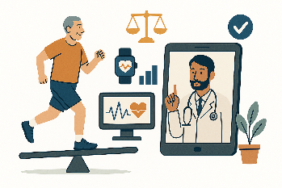
1.1 Predictive analytics for functional ability changes
Predict risks of declining functional ability before crisis
AI models learn from Finland’s RAI & ICF data, built by national organizations + partners under strict data ethics
Earlier support keeps people at home longer and helps professionals focus on care
AI turns national data into foresight for better care

Slide 10
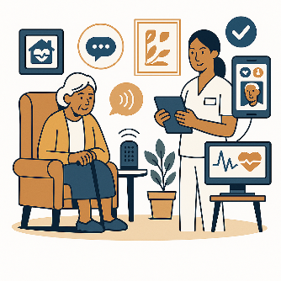
1.2 AgeTech – Independent living and elderly care
Enable seniors to live safely and independently at home
AI-driven AgeTech combines sensors, safety wearables, and medication devices with care data
Fewer emergency calls and institutional-care needs — greater wellbeing and autonomy
Smart technology supporting safe and independent living

Slide 11

1.3 Wellbeing data & predictions
Fragmented wellbeing data limits preventive work
Integrates health, social and demographic data into shared regional dashboards
More equal services and better forecasting of community needs
Data-driven insights for fair and proactive services

Slide 12
2. Interaction between professional and citizen
Finnish AI is designed to make everyday care work smoother and more human. From automated documentation to real-time translation, these tools remove repetitive tasks and language barriers. They give professionals back time for what truly matters—care, empathy, and connection. For patients, these solutions simplify and streamline care processes.
Sub-category | Core idea / problem solved | Examples / pilots / organizations | Collaboration | Impact / outcome
2.1 AI-Assisted documentation & speech recognition | Excessive manual documentation workload for staff | AI documentation assistants co-created by Finnish healthcare organizations with Microsoft and Nordic software innovators — embedded in everyday clinical work | 🏛️ 💼 🎓 | 15–35 % faster documentation; improved data quality; reduced cognitive load
2.2 Real-time translation & language support | Language barriers reduce service equality and safety | Multilingual AI communication tools (70+ languages) enabling care professionals to interact with clients directly — tested in maternity, dental, and emergency services | 🏛️ 💼 🤝 | Translation cost –80 %; improved patient safety and equality for 70 languages
2.3 Training and competence development | Professionals need scalable continuous training | MDR-certified AI training and simulation modules for continuing professional education, developed by Finnish health tech companies and universities | 💼 🎓 🏛️ | Strengthened professional skills; supports regulatory compliance (MDR/AI Act training)

Slide 13
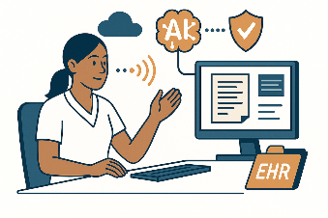
2.1 AI-Assisted documentation & speech recognition
Manual documentation overload reduces time for care
AI assistants transcribe, summarize and structure notes directly in the EHR
15–35% faster documentation, better data quality and less cognitive load
Give professionals time back for patients

Slide 14
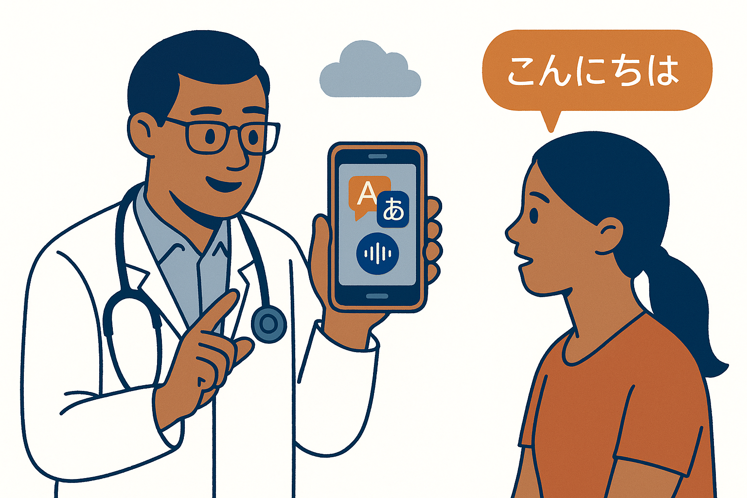
2.2 Real-time translation & language support
Communication barriers slow care and reduce equity
AI interpretation enables clear real-time interaction in 70+ languages
Encounters become faster, clearer and less costly
Give every citizen an equal voice in care

Slide 15
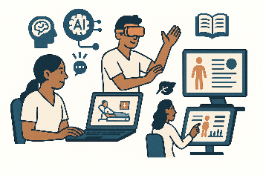
2.3 Training & competence development
Professionals need scalable, continuous AI training
MDR-certified AI training & simulation modules by Finnish tech + universities
Stronger professional skills, safer AI use, supports MDR & AI Act compliance
Scalable AI competence for a safe and skilled workforce

Slide 16
3. Diagnostics and clinical decision support
In hospitals across Finland, AI shortens the path from data to diagnosis. It detects disease patterns, analyses medical images, and flags medication risks with precision once possible only in research labs. By integrating these tools into clinical workflows, Finland turns innovation into safer and faster care.
Sub-Category | Core Idea / Problem Solved | Examples / Pilots / Organizations | Collaboration | Impact / Outcome
3.1 Imaging and diagnostic | Manual image analysis limits speed and consistency | AI-enabled medical imaging solutions co-developed by university hospitals and Nordic tech firms under European MDR standards, including cancer PET analysis automation | 🎓 💼 🏛️ | Reduces PET analysis time from 30–120 min → seconds; earlier detection of non-responders
3.2 Medication risk & treatment response prediction | Adverse drug events costly and dangerous | AI algorithms identifying medication risks and non-responders, integrated into clinical workflows and pharmacy reviews | 🏛️ 💼 🎓 | Prevents serious medication errors; saves ≈ €15 M annually; enhances patient safety
3.3 Clinical decision and documentation support | Clinicians lack structured decision support | AI-based decision support tools embedded in patient portals and digital triage systems, guiding both citizens and clinicians | 🏛️ 💼 | Faster triage; improved continuity of care; scalable to other regions

Slide 17
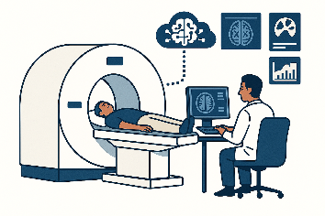
3.1 Imaging & diagnostics
Manual image analysis slows diagnostics
AI automates PET/CT/MRI analysis with MDR-certified tools
PET analysis time from 30–120 min → seconds; earlier detection of non-responders
AI imaging accelerates diagnostics and supports earlier treatment decisions

Slide 18
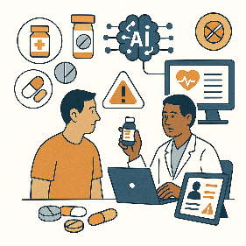
3.2 Medication risk & treatment response prediction
Adverse drug events are costly and dangerous
Algorithms identify medication risks & non-responders directly in workflows
Prevents serious errors; saves ≈ €15M annually; improves patient safety
Smarter medication decisions — safer care

Slide 19
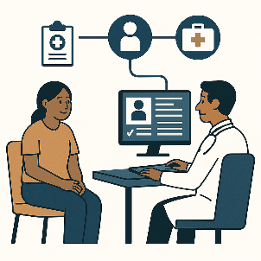
3.3 Clinical decision and documentation support
Clinicians need structured, consistent decision support
Tools embedded in triage systems and portals guide both citizens and clinicians
Faster triage, better continuity of care, scalable across regions
Structured digital guidance for safer and faster care

Slide 20
4. Care pathways
AI in social care helps professionals see the full picture of each client’s life. It summarizes complex case data and guides citizens to the right support without delay. The result is more equal, timely, and trusted welfare services across the country.
Sub-Category | Core Idea / Problem Solved | Examples / Pilots / Organizations | Collaboration | Impact / Outcome
4.1 Process automation & risk assessment | Heavy caseload and delayed child-welfare assessments | AI solutions that generate case summaries and risk insights, enabling social workers to meet legal processing times | 🏛️ 💼 🎓 | Up to 50 % less manual text work; better legal compliance; faster case handling
4.2 Client guidance and pathway recommendation | Difficult to match clients to right services | AI-driven service navigation tools connecting national e-health portals with local care options | 🏛️ 💼 🤝 | Improves access; citizens guided to right service at first contact
4.3 Ethical AI and trust frameworks | Need for transparent and explainable AI in welfare | Finland’s national AI governance and registry tools ensuring algorithmic transparency and compliance with the EU AI Act | 🏛️ 🎓 💼 | Increases institutional trust; aligns with EU AI Act and public accountability

Slide 21

4.1 Process automation & risk assessment
Heavy caseload and delayed assessments
Case summaries and risk insights generated directly into workflows
Up to 50% less manual work, faster handling and better legal compliance
Automation that strengthens safety and supports child-welfare workers

Slide 22
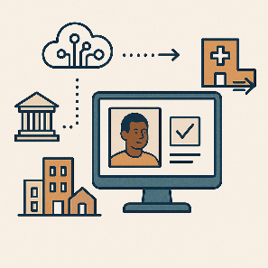
4.2 Client guidance and pathway recommendation
Heavy caseload and delayed assessments
Case summaries and risk insights generated directly into workflows
Up to 50% less manual work, faster handling and better legal compliance
Automation that strengthens safety and supports child-welfare workers

Slide 23
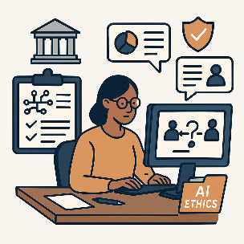
4.3 Ethical AI and trust frameworks
Limited transparency reduces trust in AI-supported decisions
Clear explanations, documented safeguards and human oversight built into workflows
More trusted decisions, safer use of AI and smoother scaling across services
Trusted and transparent AI for welfare services

Slide 24
5. Data and regulatory infrastructure
Behind every Finnish AI success lies a foundation of trust and secure data use. National infrastructures like Findata, CSC, and SPESiOR enable innovation within strict EU and national frameworks. This governance backbone makes Finland’s digital health ecosystem both reliable at home and credible abroad.
Sub-Category | Core Idea / Problem Solved | Examples / Pilots / Organizations | Collaboration | Impact / Outcome
5.1 Secondary use of health & social data (EHDS) | Limited reuse of high-value national data | National secure data environments for research and innovation — operated under Findata and private SPEs such as SPESiOR®, aligned with European Health Data Space (EHDS) standards | 🏛️ 🎓 💼 | Provides secure R&D environment; accelerates evidence generation by > 60 %
5.2 AI Act and Data Act compliance (RegTech) | Complex regulation slows innovation | Regulatory technology platforms simplifying AI Act, GDPR, and MDR compliance for innovators and authorities | 🏛️ 💼 🎓 | Simplifies compliance; cuts validation effort by 30–40 %; ensures auditability
5.3 Cloud & platform infrastructure | Need for scalable, secure deployment environments | National cloud and platform foundations providing secure, interoperable environments for data and AI | 🏛️ 💼 🎓 | Reduces time-to-deployment; ensures data sovereignty within EU cloud regions
5.4 MDR readiness & compliance | MDR classification and CE-marking create uncertainty for AI solutions entering clinical use. | Imaging-analysis AI, medication-risk models and clinical summary generators increasingly require MDR validation. | 🏛️ 💼 🎓🤝 | Enables safe deployment, reduces regulatory uncertainty, accelerates CE-marking and strengthens international market acceptance.

Slide 25

5.1 Secondary use of health & social data
Limited reuse of high-value national data
Secure data environments for research and innovation, aligned with EHDS
Faster evidence generation and safer data access
Trusted access to data that accelerates innovation

Slide 26
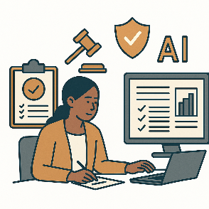
5.2 AI Act and Data Act compliance
Complex regulation slows innovation
Platforms guide teams through required steps and documentation
Faster compliance and clear auditability
Smarter tools that make compliance easy

Slide 27

5.3 Cloud & platform Infrastructure
Secure and scalable environments
Shared cloud platforms host health and social care data safely in EU regions
Faster deployment and consistent security across wellbeing areas
Reliable cloud foundations for scaling social and healthcare AI

Slide 28
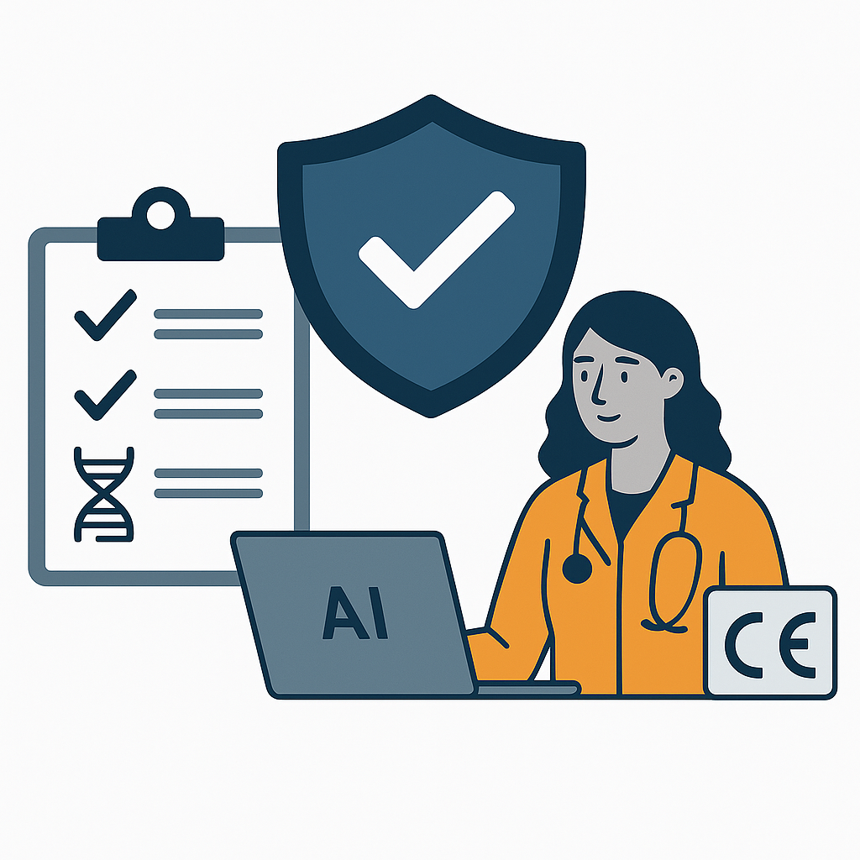
5.4 MDR readiness & compliance
Clinical AI must meet MDR safety and certification rules
MDR ensures validated, traceable and safe AI performance
Clear compliance speeds CE-marking and safe adoption
Trusted regulatory certified safety and performance for clinical AI

Slide 29
AI Solutions in Finnish Wellbeing SERVICES Counties
AI solutions are in use across Finland’s wellbeing service counties, improving diagnostics, decision-making, automation, and citizen services

Slide 30

AI development in finnish wellbeing services counties
DIGITAL HEALTH FINLAND
Overview
A total of 208 AI initiatives identified across 22 wellbeing services counties, covering diagnostics, decision support, automation, and citizen-facing services.¹
Key Trends
Since 2023, the adoption of generative AI has accelerated, transforming workflows in both healthcare and social services. AI is increasingly used to support professionals, optimize care pathways, and enhance preventive services. ¹
National Coordination
DigiFinland's national report highlights over 50 use cases, including:
AI assistants for clinicians
Automated triage and service guidance
Predictive analytics for population health²
Vision 2035
Finland aims for AI-supported, equitable, and preventive health and social services, with AI acting as a virtual colleague and health coach²
¹ UNA Oy, AI Development Snapshot in Wellbeing Services Counties, 2025:Tekoälykehittämisen tilannekuva hyvinvointialueilla - UNA Oy
² DigiFinland Oy, Final Report on AI in Health and Social Services, 2024: DigiFinland_tekoaly_loppuraportti_210324.pdf

Slide 31
Focusing AI development on wellbeing services counties: use case categories
DIGITAL HEALTH FINLAND
Figure 2.
² DigiFinland Oy, Current status of artificial intelligence development in welfare areas

Slide 32
Research Excellence in Finnish Health AI
Scientific evidence, trusted validation and world-class research for safe clinical AI.

Slide 33
Finnish universities & research institutes in health and AI
Scientific evidence, validation and research excellence
Finland’s universities and research institutes form the scientific backbone of the country’s health-AI ecosystem. They provide clinical validation environments, trusted research infrastructures, high-performance computing, and multidisciplinary expertise that ensure AI solutions meet the highest standards of safety, performance and ethical use. Together, they bridge fundamental research and real-world deployment by generating impact evidence, evaluating clinical workflows, and supporting safe scaling of AI across health and social care.

Slide 34
Key roles in Finland’s AI research landscape
Clinical validation & impact evidence
Finnish university hospitals and medical faculties lead rigorous evaluation of diagnostic AI, decision-support models and predictive systems. They generate clinical performance data, safety evidence, workflow-impact studies and real-world validation needed for MDR and AI Act compliance
Methodological excellence in AI & data science
Universities provide cutting-edge expertise in machine learning, deep learning, multimodal AI, privacy-preserving data analysis, human-centric design and explainability—core requirements for trustworthy healthcare AI
Secure research environments
Research institutions operate high-security computing environments, trusted research platforms and EU-aligned infrastructures that allow safe analysis of sensitive medical data and support large-scale AI development
High-performance computing & simulation
Finland’s academic HPC capabilities, including one of Europe’s leading supercomputers, enable large AI models, genomics-driven analytics, imaging algorithms and simulation-based training
Ethics, governance & societal impact
Interdisciplinary research groups examine fairness, transparency, safety, and the societal impact of AI in welfare and healthcare systems, contributing to responsible adoption and public trust

Slide 35

Thank you.
Notes:
Summer version

