Slide 1

Resources for the secondary use of health data
Your ready selection of solutions

Slide 2
Efforts to implement the EHDS at EU, national and healthcare levels are urgent – Key Milestones
The EHDS Regulation enters into force, marking the beginning of the transition period and preparatory work at all levels
2025
March 2027 Deadline
Commission to adopt key implementing acts
Member States to designate Health Data Access Bodies (HDAB) and one National Contact Point (NCP)
2027
Key provisions regarding the secondary use of health data enter into application.
Major efforts is required from the Member States to meet this implementation milestone.
2029
Rules on secondary use expand to apply for certain sensitive data categories, including genomic data, omics data, and clinical trial information.
2031
Third countries and international organisations may become participants in HealthData@EU, the infrastructure mechanism for secondary use
2035
Finland has already taken many of these steps and is now leveraging its experience to guide and support others.

Slide 3
How to promote the high-quality health research and implement the EHDS Regulation?
Foundation
1
Finland has developed a unique infrastructure for the modern secondary use of social and health data, building on its long tradition in high-quality epidemiological, registry-based, and health research. The country needed to update its national legislation to cater for increased requests for data protection, comply with the EU General Data Protection Regulation (GDPR), and ensure continued health research.
The new model, launched in 2019, aims to speed up access to research data and support the secure combination of datasets. Finland's experience played a key role in shaping the European Health Data Space (EHDS) Regulation (2025/327), which took effect in 2025.
Findata's responsibilities include processing permit applications and data access requests; advising data users and data holders; combining and pre-processing datasets; and providing secure access and data delivery services. Its model has been used as a reference at the EU level, and through European collaboration, it actively shares best practices.
The Act on the Secondary Use of Health and Social Data (552/2019) laid the foundation for secure and efficient secondary use of health and social data, enabling safe processing of personal data for research, statistics, policy-making, and innovation.
Infrastructure
Development
2
Finland's secondary use infrastructure progressed from planning to implementation with priorities including public trust, strong data protection, interoperability between registries, and streamlined processes to facilitate data access.
Findata Establishment
3
Findata serves as Finland's data permit authority and fulfills the role of the Health Data Access Body (HDAB) under the EHDS Regulation, operating as a "one-stop shop" for data access from multiple sources.

Slide 4








An emerging ecosystem for
the secondary use of social and health data
Data Creators & Controllers
Data Users
Organizations in social and health care sectors collect and manage personal data, acting as data controllers for patient records with statutory obligations to make data available for approved secondary purposes.
Academic researchers, universities, research institutions, businesses, innovators, pharmaceutical companies, health tech firms, and startups leverage social and health data for various purposes.
Supporting Stakeholders
Authorization
Ministry of Social Affairs and Health, innovation funders, Data Protection Ombudsman, and ethical review boards ensure lawful and ethical processing of personal data, as well as certification bodies for secure processing environments.
Single-source data can be authorized by the controller, while multi-source data requires Findata's coordination to combine datasets from different sources.
Several public organisations play important roles in ensuring data quality and integration. The Finnish Institute for Health and Welfare (THL) maintains national health registries; the Social Insurance Institution of Finland (Kela) manages data on social security benefits and prescriptions; and Statistics Finland holds population and cause-of-death data.
Other key actors include the Finnish Center for Pensions, the Digital and Population Data Services Agency (DVV), the Finnish Institute of Occupational Health, and regulatory agencies like Valvira and Fimea, which oversee social and health care and manage pharmaceutical-related registries.
Finland's comprehensive registries attract both national and international research groups. Through Findata, multinational research projects can obtain Finnish datasets in a unified package, making the country a hub for health data research.

Slide 5

The technical infrastructure for the modern secondary use has been created
A modern data platform
Finland’s secondary use infrastructure is built on a modern data platform that securely connects registries and provides turnkey analytics services. The platform is designed to be flexible yet strictly controlled.
High-quality research places high demands on data. All data controllers are required to describe their datasets, supported by Finland’s national metadata system Aineistoeditori.
Secure-by-design access
Research datasets compiled by Findata are made available in a secure remote access environment. To ensure data protection, only the results of the analysis may be extracted - never the raw data itself.
Secure processing environments
Finland hosts ten certified Secure Processing Environments (SPEs), including Findata's own Kapseli. This ecosystem offers users flexibility in choosing secure data access services. Kapseli operates on scalable virtual servers, with adjustable resources tailored to project requirements.
Health data lakes
Several healthcare providers maintain health data lakes that offer structured access to local clinical data. These centralized repositories collect diverse health information for processing and use, playing a crucial role in evidence-based decision-making and innovation. For example, the Varsinais-Suomi wellbeing area's data lake contains data from several dozen source systems covering specialized healthcare.
Supercomputer Lumi
LUMI is one of the world's fastest and most energy-efficient supercomputers, located in Kajaani, Finland. It supports life sciences and medicine by providing unprecedented computational power. Finnish health tech company Gosta Labs leverages LUMI to develop specialized language models for healthcare, with their AI assistant Gosta Aide automating patient documentation.
Continuous development
Current efforts focus on improving usability—such as advancing metadata search tools and digitalizing the permit process—as well as preparing for international interoperability through EHDS interfaces and shared European data standards. Resources are continually reinforced to ensure reliability with growing data volumes and user needs.

Slide 6






Tackling challenges
Legal Interpretation
Permit Procedures
Security vs. Usability
The interpretation of the new Secondary Use Act alongside related legislation proved complex. Issues such as the role of patient consent in registry-based research and defining what constitutes secondary use raised legal uncertainties.
Lesson: Provide clear and timely application guidelines to ensure users understand the rules from the start.
Setting up new permit procedures took time. Ambiguities in the legal framework initially slowed the issuance of permits. User feedback helped identify critical pain points, which were then addressed.
Lesson: Early phases of implementation must be supported by sufficient resources and thorough process testing before full-scale rollout.
Stricter data security requirements have been perceived by researchers as complex administrative regulations. Striking the right balance between researchers' need for data and protection of individual privacy remains a challenge.
Lesson: Actively listening to user feedback has led to expanded guidance and refined interpretations.
Cost and Resource Challenges
Technical Infrastructure
Artificial Intelligence and Secondary Use
While cost-recovery is a guiding principle, many research groups have perceived secondary use to be more expensive than before. The establishment of Findata made the real costs of data extraction and secure processing more transparent.
Lesson: With the implementation of EHDS, additional investments will be needed, and without proper planning, some costs may be passed on to users in higher service fees.
The technical infrastructure must handle massive volumes of data. Initially, datasets requiring high computing capacity—such as genomic data—could not be processed efficiently.
Lesson: The situation has improved through multiple processing environments and additional infrastructure investments.
AI technologies are increasingly linked to secondary data use, often evolving faster than regulation. Currently, many secure processing environments lack native support for AI development. Service providers are already applying advanced solutions such as Veil.AI's privacy-preserving technologies, HUS's federated data access model, and SWARM architecture.
Lesson: Updates to the Secondary Use Act are needed that will better support AI-driven research and innovation.
Public expectations were high at the outset, and when challenges emerged, discourse quickly turned critical.
Lesson: Proactive communication about successes, setbacks, and corrective actions is essential to ensure stakeholders recognize progress and maintain trust in the system.

Slide 7
Success stories
1,418
62
10
1,100+
Decisions Issued
Data Controllers
Secure Environments
Research Projects
Findata has issued 1,418 decisions, including complex cases involving data from up to 23 different data controllers.
Data decisions have involved datasets from 62 different controllers, demonstrating the breadth of Finland's health data ecosystem.
Finland now operates ten EHDS-compliant Secure Processing Environments (SPEs), serving around 5,000 users.
Over 1,100 ongoing research projects are supported by Finland's secure processing environments.
Findata's Achievements
FinnGen - Genome and Digital Health Data
Findata began operations without a direct predecessor, rapidly establishing a technical and operational framework that met GDPR requirements while ensuring the continuity of scientific research. In just five years, Findata has built a robust infrastructure that seamlessly integrates key components: permit processes, data merging, secure data access through certified environments, and expert guidance for users.
FinnGen is a globally significant personalized medicine initiative collecting and analyzing genome data and digital health records from over 500,000 Finnish biobank participants—close to 10% of the population. The data is used to discover new biological mechanisms of disease, prioritize drug targets, accelerate drug development, improve individualized treatment decisions, and enable prevention based on genetic risk.
This exceptional public-private collaboration brings together Finnish universities, hospital districts, biobanks, the Finnish Institute for Health and Welfare, the Finnish Red Cross Blood Service, and hundreds of thousands of volunteer participants. Several global pharmaceutical companies have joined as partners, attracted by access to this unique combination of longitudinal phenotypic and genomic data.
Health and Social Data Integration
A unique feature of Finland's system is the integration of health and social care, coordinated through the country's wellbeing services counties. Finland's Secondary Use Act applies to both health and social data, significantly boosting research in the social care domain and improving the quality and availability of data from social care registers.

Slide 8
International networking opportunities for
the cross-border secondary use of health data
Findata shaping European development
While Finland’s secondary use system is national in scope, it is designed to be fully interoperable at the European level. Findata actively participates in EU-funded projects developing cross-border data discovery and analysis capabilities.
A concrete example is the Memorandum of Understanding signed between Findata and France’s Health Data Hub (HDH), sharing technical solutions and operational models to support harmonized development. Active international cooperation is a way for Findata to promote the national and European implementation of the EHDS Regulation.
Fingenious - Gateway to Finnish Biobanks and Biomedical Research
Finnish Biobank Cooperative (FINBB) coordinates the infrastructure of all biobanks. Its Fingenious brings through a single-point of contact access to Finnish biobanks’ biospecimens, data, study participant finding, and expertise for academic and industry researchers globally. Fingenious Ecosystem is a collaboration network of public, academic and private actors on biomedical research services, facilitating real-world evidence and real-world data projects.
Universities are active counterparts in international projects
Finnish universities actively participate in international projects and welcome new collaborations. Some examples:
UEF Connect is the University of Eastern Finland's expert search service, where you find information about the university's experts, research topics, groups, projects and networks.
The University of Oulu promotes international efforts through a dedicated office as a point of contact for partners. Oulu is open to cross-border projects, events, and other cooperation.
The Helsinki University is an active partner in several innovative projects. One example is the CleverHealth Network, a health technology ecosystem, where companies and healthcare professionals co-develop better care and health technology products. The other example is the HUS Academic secure processing environment presented in this brochure.
Laurea University of Applied Sciences partners in international networks, such as the Xpanding Innovative Alliance (XiA) (digital healthcare) and UkraineDigiTrans (medical education).
Sitra – the international coordinator
Sitra, the Innovation Fund, coordinates international health dataprojects and promotes international cooperation. TEHDAS2, a joint action funded by the EU and member states, creates guidelines and technical specifications for using health data in EU for harmonised implementation of the EHDS legislation. It aims for harmonised implementation of the EHDS legislation, which facilitates research, innovation and policymaking.
Valo, funded by the Nordic Council of Ministers, brings together Nordic and Baltic countries to share experiences when planning and implementing the EHDS regulation. Further, Sitra partners in the European Data Spaces Support Centre, enhancing data sharing and innovation across sectors.

Slide 9
Finland as your partner for the secondary use of health and social data
Finland offers end-to-end expertise and ready building blocks to help you develop and scale secondary use of health and social care data in a safe, compliant and practical way.
Support is available from early-stage planning to implementation: from policy, legal and operational advisory to services and solutions for data governance and information management, user-facing digital services such as access portals, and secure processing environments and cybersecurity capabilities that enable compliant use of sensitive data.

Slide 10



Solutions and solution providers
Short presentations on networks, ready solutions and solution providers
Notes:
Winter version

Slide 11

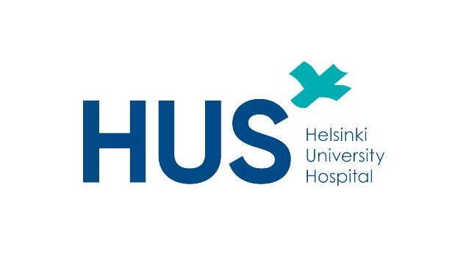
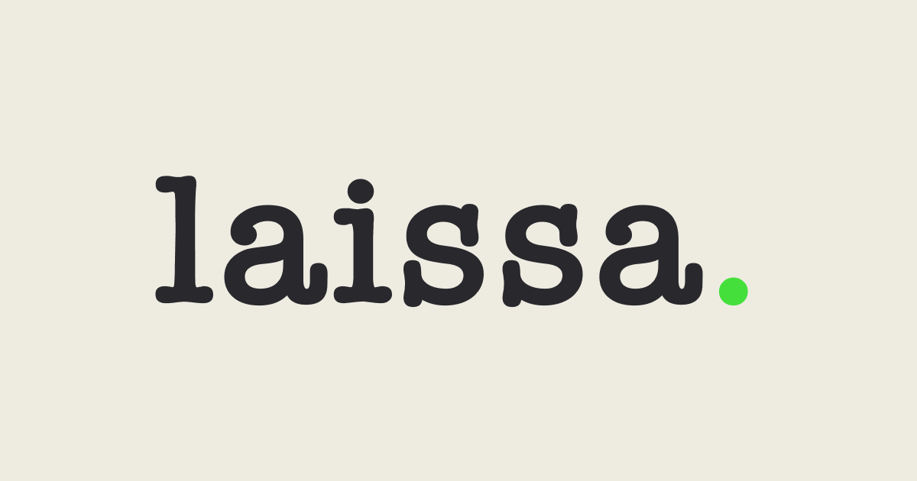
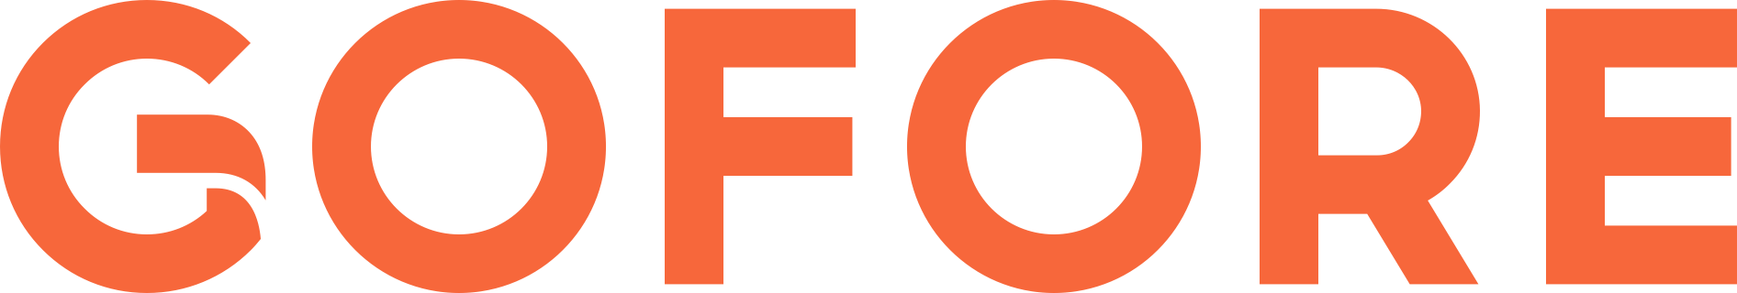
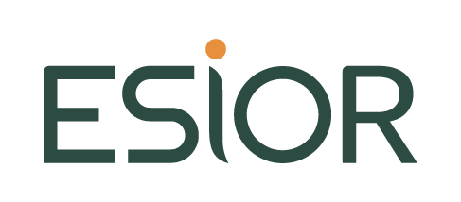

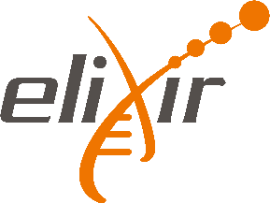


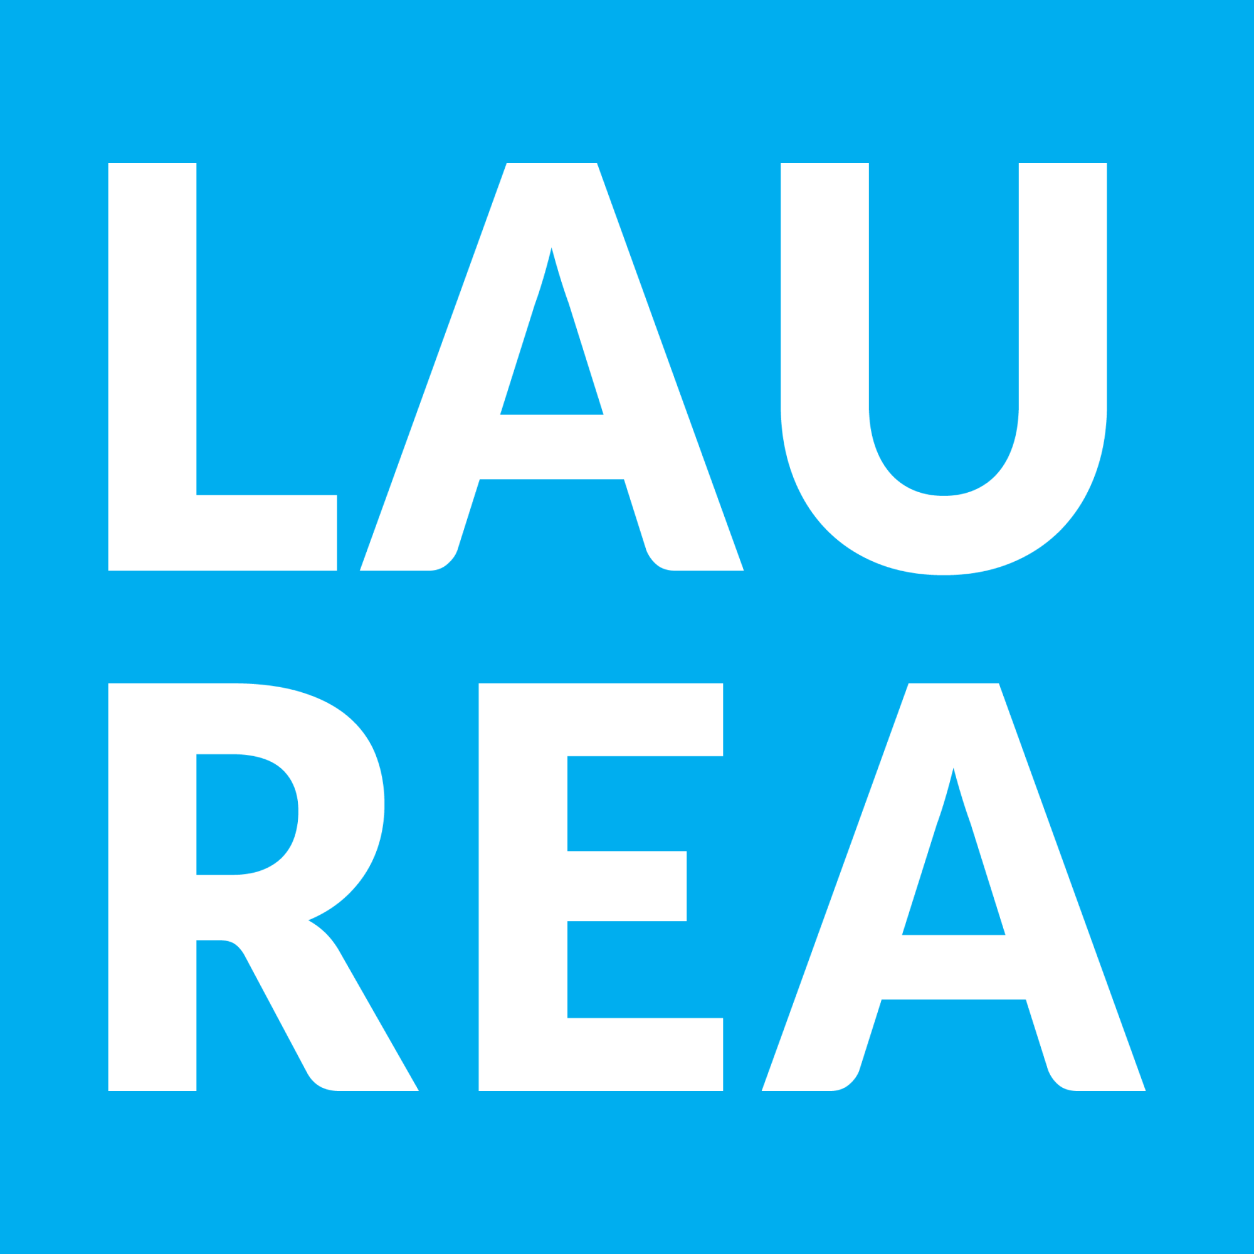
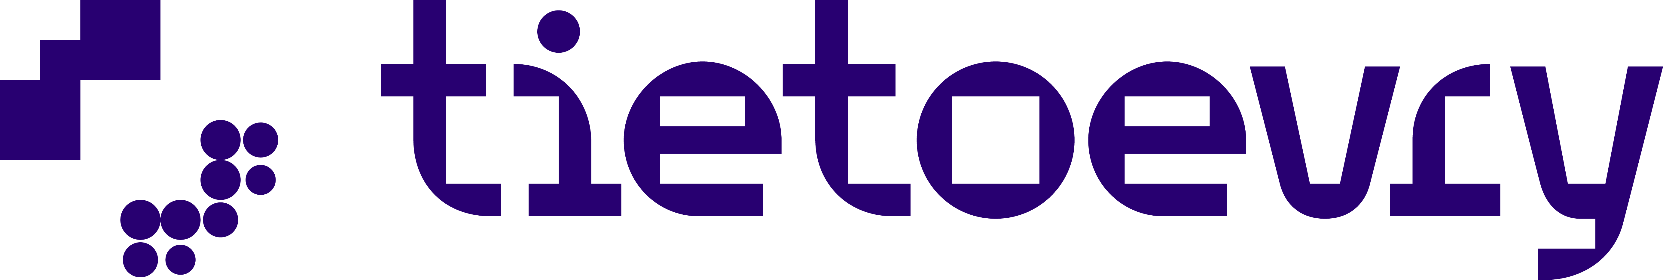

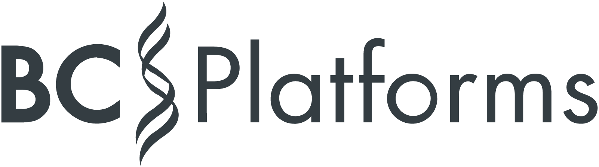






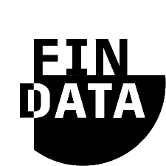

Legal and strategy consultations
Secure processing environment
Solutions and solution providers for the secondary use of health and social data
International networking
and research opportunities
Data management and analytics
Government and agencies

Slide 12

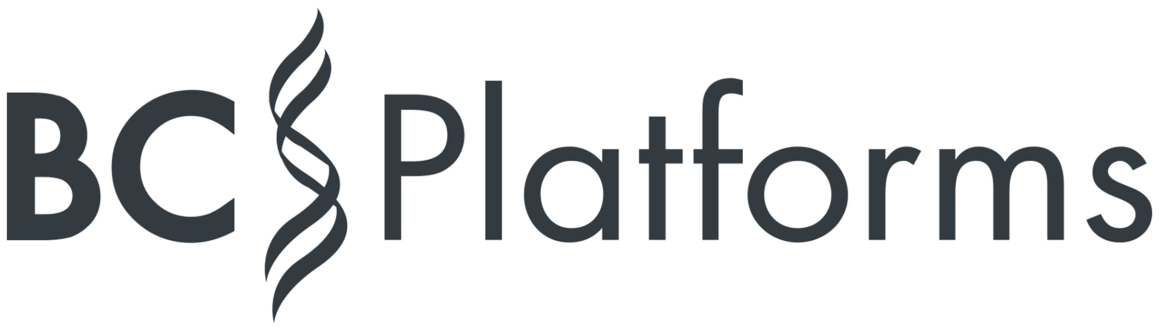







Solutions and solution providers
Short presentations – The list is expanding
Laissa – Legal services
Gofore – Strategy and consulting services
KPMG - Cyber Security certification, audits and assurance
HUS Academic - Secure processing environment
CSC – Management of sensitive research data
Esior – Research, a security processing environment
Veil.ai – Data anonymization and synthesis
BC Platforms – EHDS compatible Trusted Research Environment
TietoEvry – Data management, analytics and AI solutions
BCB Medical – Data management and analytics
Fingenious – Gateway to collections and services of the Finnish biobanks
Fingenious Ecosystem - Gateway to Finnish Biomedical Research

Slide 13

Legal services
Deep industry knowledge and practical legal expertise. In-house counsel as a service. At a scale and price point that fits your business.
Our offering
Laissa provides specialized legal counsel for life Science, health, deep tech, ICT and hospital supply industries. We have hands-on experience navigating industry-specific agreements, R&D and regulatory challenges. We are experts in commercial contracts, regulatory compliance, licensing agreements and strategies, data protection, marketing authorizations, product liability risk management, and sustainable business practices.
Company
Laissa is a legal counsel based in Helsinki. Our team of industry experts includes legal professionals specialized in the health field. We have extensive experience in bio- and medtech, diagnostics and digital health (incl. Artificial Intelligence)
Benefits and references
Our services are ideal for companies needing regular support but not a full-time lawyer, and for tailored country counsel assignment, e.g. board support, marketing and sales contacts, HR. We provide fast responses and integration with the local business team.
Laissa team experience consists of Healthtech Finland Industry Association, Microsoft, Nexstim, Polar, Nokia Corporation, Finnish Defence Forces.
Contact
Sandra Liede
Health Tech Lawyer
Sandra.liede@laissa.fi
+358407001658
www.laissa.fi

Slide 14
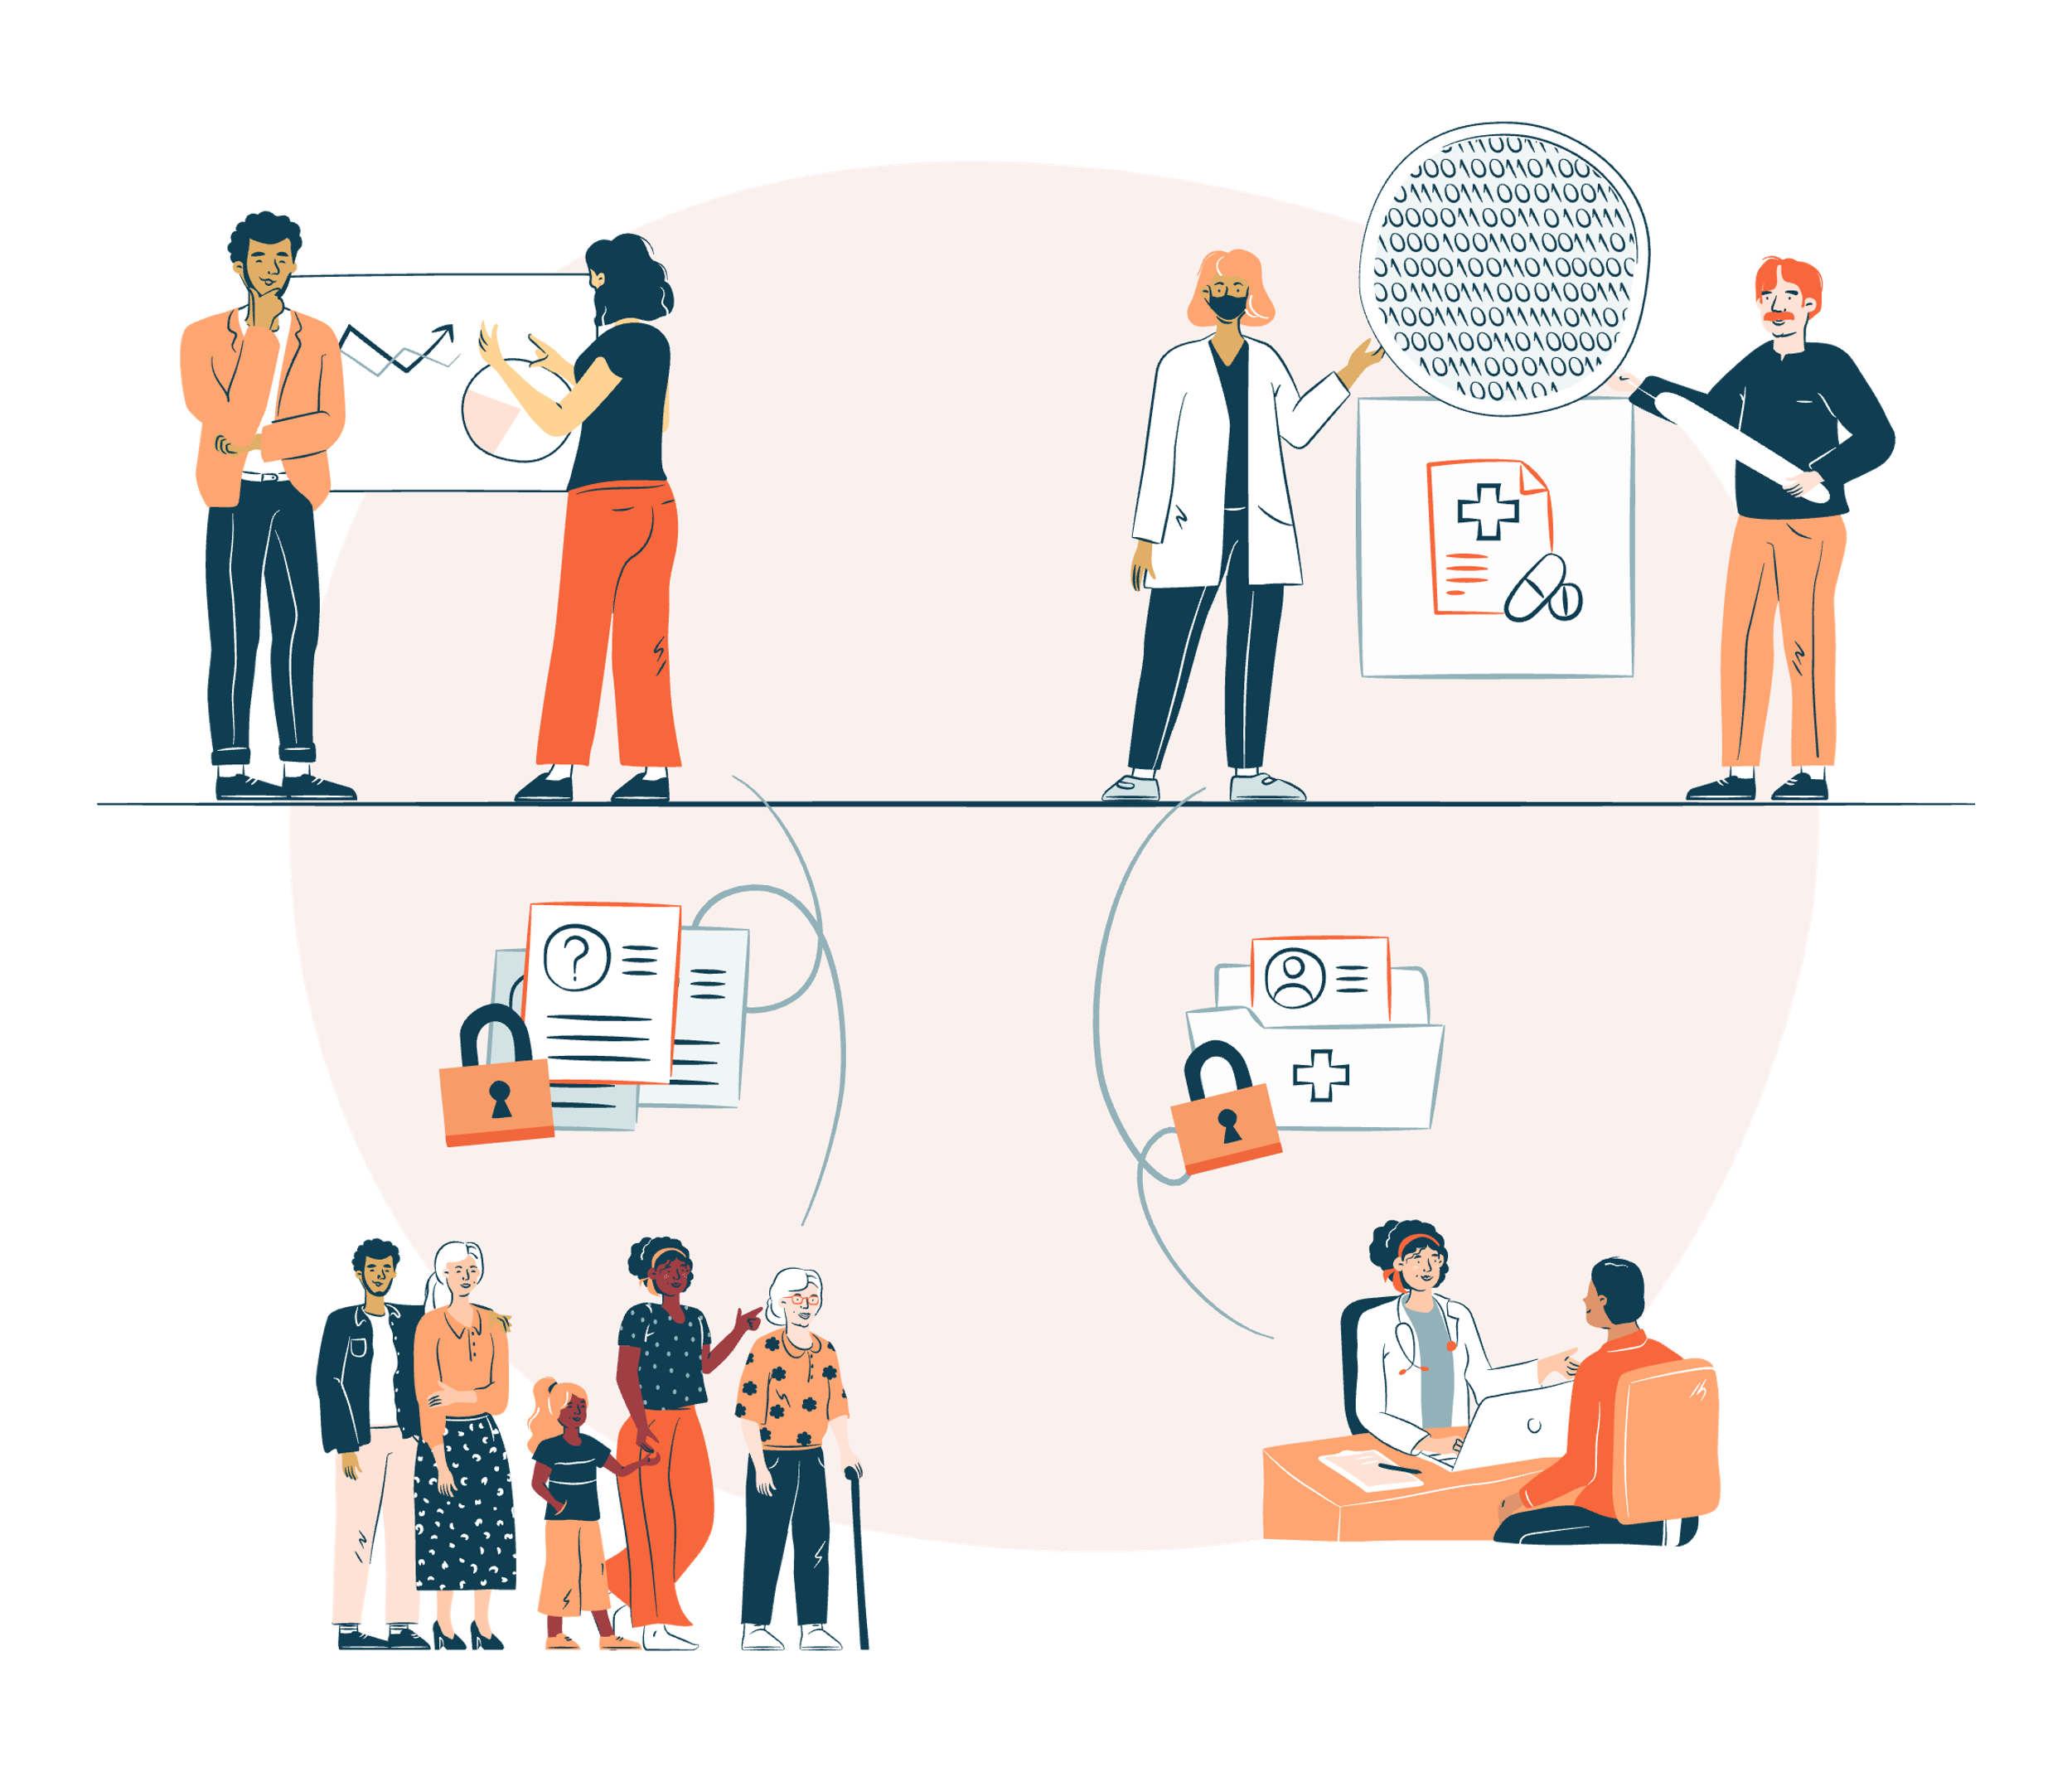
Strategy and consulting services
Leverage the lessons learned from Finland through our consultancy services to advance the development of secondary use of health and social data.
Our offering
We help design ethically sustainable digital solutions and operating models for secondary use of health and social data in secure way including architectural design, process development, project management, service and business design and software development.
Company
Gofore is an international digital transformation consultancy with Finnish roots, founded in 2001. We employ nearly 1,500 experts across 18 locations in Finland, Germany, Austria, Spain, and Estonia. With our technology and business expertise, we work for functional, secure and equal services for the digital society.
Benefits and references
We have been actively involved in developing Finland’s secondary use infrastructure. At Gofore, we offer extensive experience and insights from Finnish solutions to help enable secure secondary use. We have worked with Ministry of Social Affairs and Health, Finnish Institute for Health and Welfare and the Social Insurance Institution of Finland.
Contact
Antto Seppälä
Director, Strategy and Consulting Services
Antto.Seppala@gofore.com
+358 40 706 9919
www.gofore.com

Slide 15

Cyber Security certification, audits and assurance
Certification for your secure processing environment
Our offering
KPMG IT Certification Ltd provides expert certification services in the fields of cybersecurity and data privacy.
We also conduct certification audits for secure processing environments, ensuring the protection of sensitive social and health data.
Company
KPMG IT Certification delivers comprehensive cyber and privacy audits, including ISAE/SOC assurance and ISO certifications. Our services also cover technical security testing for information systems, cloud platforms, applications, mobile devices, and operational technology (OT).
Benefits and references
Our certification services give you confidence that your systems securely process and store social and health data while meeting all privacy regulations.
With a proven track record, we’ve certified over 100 healthcare systems and 70% of secure processing environments—helping organizations build trust and ensure compliance.
Contact
Olli knuuti
Partner
olli.knuuti@kpmg.fi
+358401625620

Slide 16


Secure processing environment and Research platform
Leverage HUS Acamedic, a Secure Processing Environment (SPE), to run your study in a virtual, globally accessible SaaS workspace designed for the secondary use of healthcare data.
Our offering
As Finland’s largest university hospital, we at HUS have spent the past eight years developing HUS Acamedic, a secure processing environment that has been rigorously audited for the secondary use of healthcare data. HUS Acamedic is available worldwide for researchers who need a trusted platform for health-data studies.
Company
HUS, Helsinki University Hospital, is a public organization and a healthcare provider in Finland, headquartered in Helsinki. Established in 1830, it specializes in advanced medical care and handles rare and severe diseases nationwide.
Benefits and references
HUS Acamedic provides a secure processing environment for secondary use of health care data, ensuring data privacy and compliance with regulations. The virtual and globally accessible nature of the solution allows researchers from around the world to collaborate and access valuable health care data for their studies.
iCAN is using HUS Acamedic on their research: https://ican.fi/
Contact
Emmi Turunen
Product manager
Emmi.Turunen@hus.fi
+358404819467
https://www.hus.fi/ HUS

Slide 17
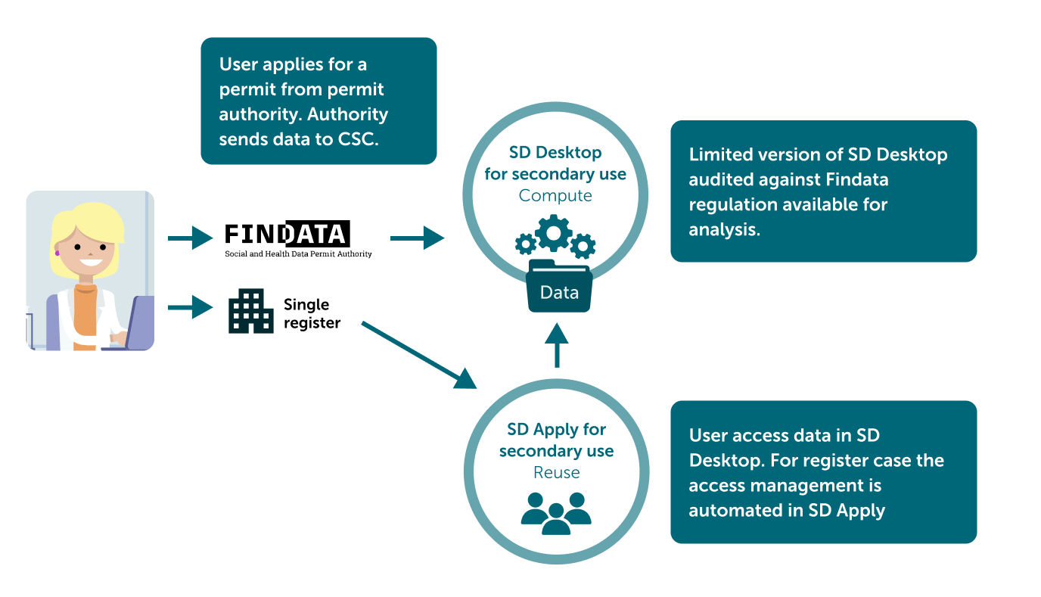
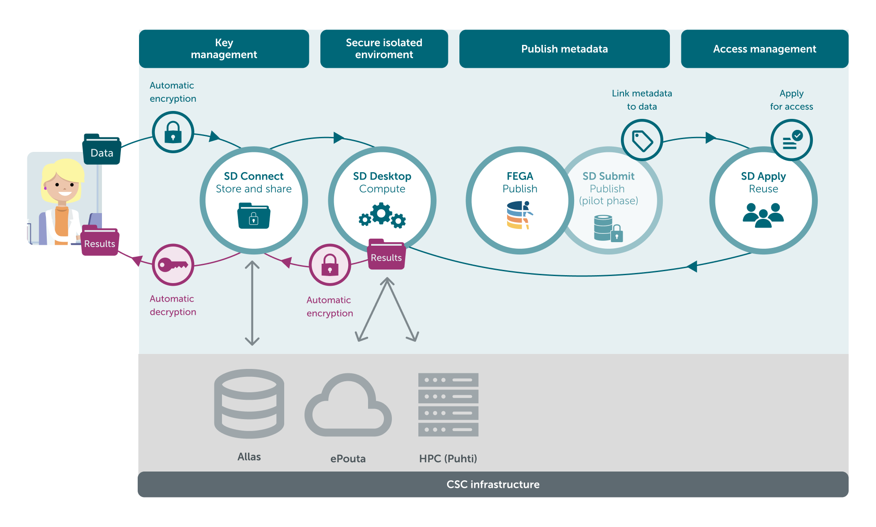
Secure services for managing sensitive research data
CSC provides secure and scalable solutions for sensitive research data management and analysis
Our offering
We offer secure, audited and scalable services for managing sensitive research data in full compliance with Finnish legislation and GDPR. Our expertise supports national organizations—such as Findata and Statistics Finland—in meeting their data management and service delivery needs. Through ELIXIR, we also bridge European life science competences to enhance our services and foster international collaboration.
Company
CSC is a Finnish center of expertise providing high-performance computing, data management, and digital services to support research, education, public administration, and innovation. We bridge science and technology, offering secure, scalable, and sustainable digital solutions that empower national and international collaboration.
Benefits and references
Access powerful, secure data tools directly from your browser—no local setup needed. Our services are free for researchers and students at Finnish institutions, with built-in support for safe international collaboration and joint analysis. Our target users include national researchers, public authorities, and their collaborators.
Contact
Charlotte Granberg-Haakana
Customer solution manager, sensitive data
Charlotte.Granberg-Haakana@csc.fi
www.csc.fi/en/our-expertise/sensitive-data/

Slide 18
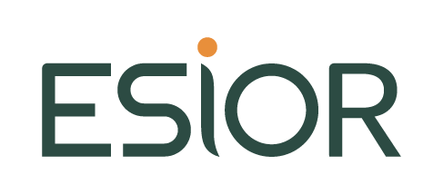
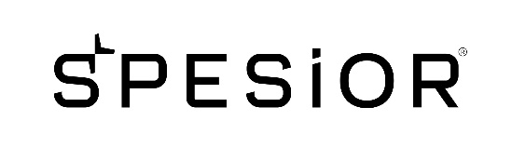
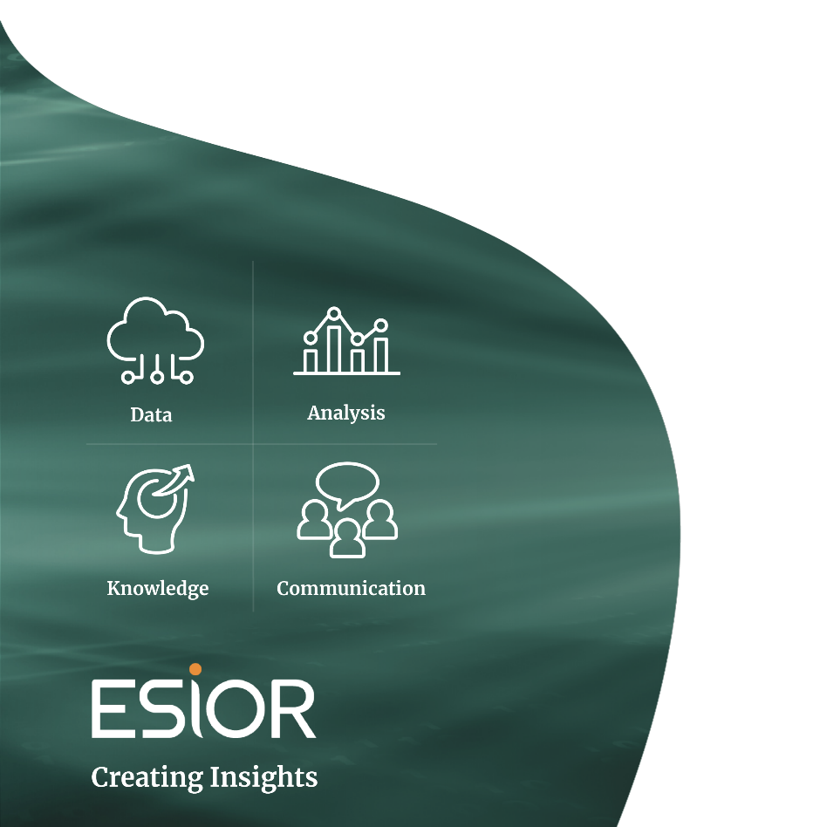

Secure Processing Environment and Data analytics
From data to competitive advantage™ - data access, secure analysis, knowledge management, communication content, and market access.
Our offering
At ESiOR, our offerings span: DSEG services, evidence synthesis, RWE studies, external control arms, interface modelling and related applications; SPESiOR®, an EHDS-compliant private-cloud SPE that manages the entire data lifecycle; SHEOR services covering effectiveness, cost-effectiveness, HTA, process evaluation, cost studies, predictive modelling and risk-sharing; and Nordic market-access services, from landscape analysis and consultancy to reimbursement submissions, conditional reimbursement and risk-sharing strategies.
Company
ESiOR Oy is a private expert organization that creates insights and value from data and evidence and provides secure processing environment (SPE) called as SPESiOR®. ESiOR has solid experience in research, social and health economics and outcomes research (SHEOR), data science and evidence generation (DSEG), and market access. ESiOR Oy has a strong track record of client success, with over 800 projects, over 400 scientific publications, and more than 15 innovations and at least 5 international awards.
Benefits and references
The experts and solutions at ESiOR are driven by data, aim at credible insight and trustworthy value, and leave no stone unturned when finding the best solutions for developing and communicating their clients’ competitive advantages. Testimonials:
“Great to see that studies carried out in the SPESiOR environment produce results that impact on health policy.“
”Looking forward to carry out more RWD and HEOR studies in cooperation with stakeholders.”
“Easy collaboration.”
Contact
Erkki Soini
CEO, Health Economist
Erkki.soini@esior.fi
+358 40 0533 971
Janne Martikainen
Managing partner
Janne.martikainen@esior.fi
+358 44 0718 243
www.esior.fi

Slide 19

Data anonymization and synthesis
Use health datasets safely by employing our AI/ML library and toolkit that delivers high-quality anonymization of structured data, converting sensitive information into row-level, anonymous, GDPR-compliant form.
Our offering
At VEIL.AI, we solve the key issue of making health data safe to use and share for AI development, RWE and data sharing. Our next-generation AI/ML library delivers high-quality anonymisation and is available both as SaaS and as a Snowflake Native App, empowering healthcare industry, RWE/CRO consultants, health providers and data holders.
Company
VEIL.AI is a University of Helsinki deep tech spin-out company. We develop and offer an AI/ML library and software, providing high quality data anonymization and synthetization with data privacy and quality analysis, complemented by professional services.
We at VEIL.AI are focused on automating structured data anonymization process and solving complex data anonymization challenges.
Benefits and references
Pharma, med-tech, tech firms and researchers all need rich health datasets for real-world evidence and AI training, yet GDPR, the forthcoming EU AI Act and the EHDS demand fully anonymous use to safeguard privacy. Our VEIL.AI technology uniquely delivers both high data utility and GDPR-compliant anonymity.
A published study with Bayer AG:
Mehtälä, J. et al. Utilization of anonymization techniques to create an external control arm for clinical trial data. BMC Med Res Methodol 23, 258 (2023). https://doi.org/10.1186/s12874-023-02082-5
Contact
Tuomo Pentikäinen
CEO
tuomo.pentikainen@veil.ai
Juha Paakkola
CCO
juha.paakkola@veil.ai
www.veil.ai

Slide 20


Trusted data management and Data analysis
European Health Data Space compatible Trusted Research Environment systems for life science research
Our offering
AI enhanced software solutions for streamlining Data Discovery, Data Access application management, Data release processes and Data analysis.
We provide Data Discovery portal for researchers and Trusted Research Environment (TRE) systems for research hospitals.
Company
BC Platforms, founded 1997, is a technology company pioneering the future of Real-World Data (RWD) excellence. We offer software solutions, a global data network and professional services for pharma and healthcare industry. We operate globally with offices in Finland, Boston, UK, France, Switzerland, Sweden, Singapore and Japan.
EHDS-Ready
TRE.
Benefits and references
By process automation, controlled access to un-concented patient data can be shortened from months or years to days or weeks without compromising citizens privacy or trust.
We have delivered national scale Data Discovery systems e.g. to UK (HDR) and Japan (NTT).
Contact
Karl Quinn, PhD MBA
Global Head, Alliance & Channels
karl.quinn@bcplatforms.com
+44 7383 316822
www.bcplatforms.com

Slide 21


Data, analytics and AI solutions
Manage, analyze and share sensitive health data with Lifecare Data Platform - the high security platform providing central access point to the customer’s big data assets.
Our offering
Lifecare Data Platform is a cloud-based solution built for secure processing of sensitive health data. The platform provides capabilities for data ingestion, transformation and analysis with latest AI technology. It is designed for healthcare organizations with large data volumes, research, innovation, and BI and AI development.
Company
Tietoevry Care is a leading provider of health and social care software in the Nordics. We are modernizing the health and social care sector with our modular, open, and interoperable Lifecare software, supporting the daily lives of over 10 million citizens. Tietoevry Care serves over 1000 customer organizations in the Nordics and employees 1600 professionals.
Benefits and references
Lifecare Data Platform provides a secure health data infrastructure as a service enabling the customer to focus on drawing value of their big data and building intelligent data-driven solutions for their business needs
Platform at Helsinki University Hospital’s (HUS) is the most advanced data platform in EU. It contains big data from over 3,5 million patients and serves number of analytics, AI and business systems.
Contact
Joona Pylkäs
Head of Data & AI
Joona.pylkas@tietoevry.com
+358445900900
Lifecare Data Platform - Actionable insights for better care

Slide 22

Data Management and Analytics
Bringing Data to Life
BCB Medical – Transforming Data into Clinical and Operational Intelligence
Our offering
BCB Medical is a healthcare software company specialised in collecting and analysing clinical data.
We offer a disease specific platform and patient engagement system combined with AI-powered data analytic tools to create insights and enable value-based decisions in healthcare.
Company
BCB Medical provides technology which manages clinical data, from collection to conclusion. The company is established in 2003 and today, we employ a total of 65 people in Finland, in Sweden and in the UK.
BCB Medical is certified according to MDR, ISO 13485 and ISO 27001 requirements.
Benefits and references
We support healthcare organisations improving the quality of care and optimising the use of healthcare resources.
Collated, structured, data, can be utilised in clinical treatment decisions and in various scientific research and life science projects.
Our solutions are in active use in over 400 clinics in Finland, in Sweden and in the UK. Read more about our customer experiences: https://bcbmedical.com/our-customers/
Contact
Minna Palhamo
CEO
minna.palhamo@bcbmedical.com
+358 40 037 7010
Jaakko Erjanti
CPO
jaakko.erjanti@bcbmedical.com
+358 50 550 4696
www.bcbmedical.com

Slide 23
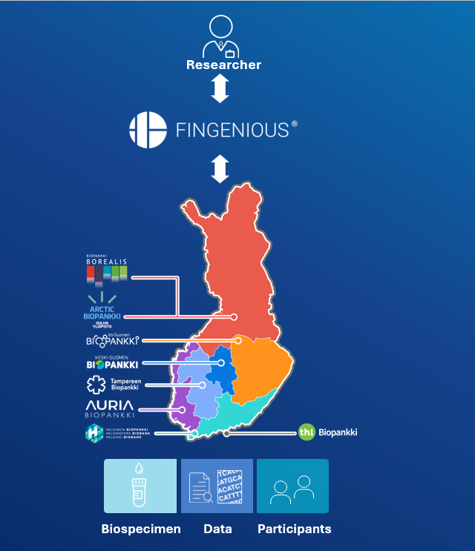
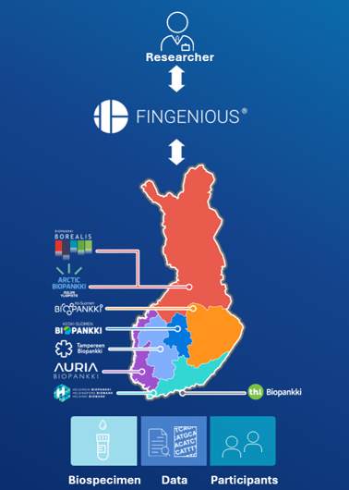
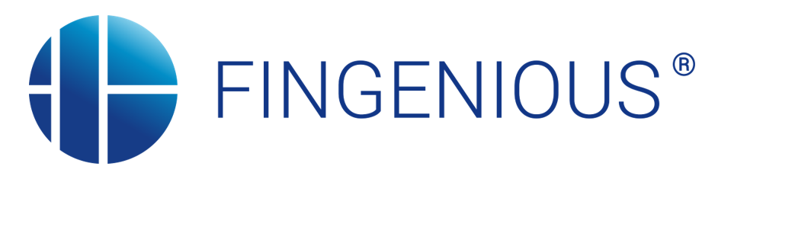
Gateway to collections and services of the Finnish biobanks
Fingenious® services - the Gateway to Finnish Biobanks and Biomedical Research
Our offering
Fingenious® service, operated by FINBB, provides a single-point solution to access Finnish biobanks’ biospecimens, data, study participant finding, and expertise. This service is available to academic and industry researchers globally to support biomedical research efforts from basic research and early discovery to pre-approval R&D and post-approval studies.
Benefits and references
Fingenious service offers researchers an agile and seamless fast-track to their desired combination of samples and data from Finnish biobanks, and targeted recontacting of biobank sample donors for further studies like clinical trials. All of this is available through one contact point and one contract.
Find research collaboration examples and get to know Fingenious service at:
https://site.fingenious.fi/en/use-cases.
Company
Finnish Biobank Cooperative – FINBB is the national coordinator of the Finnish biobank infrastructure. With its Fingenious service it provides a centralized access point to the biobank and data services of its owners and collaborators to researchers worldwide.
FINBB is owned by Finland’s largest health care providers, universities, and the Finnish Institute for Health and Welfare.
Contact
Johanna Mäkelä, PhD
Director of Research and Services
Finnish Biobank Cooperative – FINBB
+358 50 516 2844
info@fingenious.fi
www.fingenious.fi

Slide 24
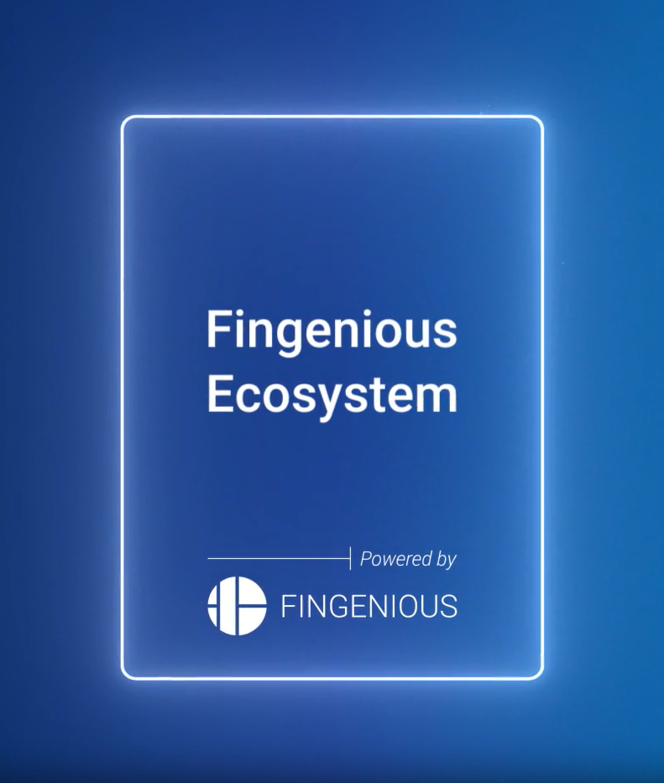
Gateway to Finnish Biomedical Research
Easier RWE and RWD research with Fingenious Ecosystem Partners
Our offering
The Fingenious Ecosystem is a collaboration network of public, academic, and private actors that provides a single access point to Finnish biomedical research services, facilitating real-world evidence (RWE) and real-world data (RWD) projects.
Its services include a catalog of partners offering technology, data & sample sources, analytics, consultation, and help with permit and application processes.
Benefits and references
Researchers can streamline the process of applying for data permits, gain insight into longitudinal Finnish datasets, and tap into local regulatory and institutional advantages.
A unified catalog lets users browse the offerings of ecosystem actors easily, and the service is supported by Finnish national institutions – e.g. the Ministry of Social Affairs & Health, FINBB, THL, and Findata.
Company
The ecosystem is coordinated by FINBB (Finnish Biobank Cooperative) and the Finnish Institute for Health and Welfare (THL), with steering input from Findata and the Ministry of Social Affairs & Health.
Fingenious is presented as a digital gateway to Finnish biobanks, aiming to harmonize infrastructure and processes to boost Finland’s position in biomedical research.
Contact
Contact ecosystem

Slide 25

DIGITAL HEALTH
FINLAND
Related brochures from Business Finland
– World idea in health - healthcare (2025)
– A treasure trove for real-world evidence research (2022, updated partly 2025)
– A global leader in digital health innovation (2025)
The folder contains also other health-related brochures.
Contacts
Digital Health Finland
Tomi Laitinen, Ministry of Social Affairs and Health
tomi.laitinen@gov.fi
Veera Virta, Oulu University
veera.virta@oulu.fi
Secondary use of health data
Tapani Piha
tapani.piha@pihanet.net
You are invited to contact directly
the companies and agencies
presented in this compendium.
Further information
Ministry of Social Affairs and Health
Finnish Institute of Health and Welfare
Findata – Social and Health Data Permit Authority

