Slide 1

Agetech Finland
Finnish agetech expertise and services

Slide 2
Finland is a country of digital health
5,6M
6%
100%
€2,57B
Population
One of the Nordic welfare states
Aging population, healthcare workforce shortages, and economic pressures faced by advancing digital health and embracing technology as a strategic enabler
Aging
6% of Finns aged 80 or older (2024)
Amount expected to double by 2030 (up to 7% of the population)
Digital health infrastructure
100% electronic medical records digitally accessible via Kanta service
Enabling legislation, also for secondary use of health data
Governmental commitment to digitalisation and AI
Export-driven health tech ecosystem
Health technology export value €2.57 billion (2024)
Strong research capabilities, vibrant startup culture and testbed operations supporting innovations

Slide 3

The silent revolution of Finnish elderly care.
Growing old safely, with dignity, and by staying connected to others.

Slide 4
In Finland, things tend to happen quietly.
No need for big words or bold claims - just steady work and practical results. That’s how change takes root here. And when it comes to elderly care, a quiet but meaningful shift is already underway.
Faced with a rapidly aging population, Finland spent a decade incrementally reforming and integrating its health and social care system. In 2023, a major reform centralized care under 22 new Wellbeing Service Counties governed and funded nationally - ensuring even sparsely populated rural areas get equal access to services. This coordinated approach, combined with high trust in technology and a robust digital and data infrastructure allows Finnish eldercare to efficiently deliver innovative “aging in place” services.
The result is a quiet revolution: Finland’s seniors benefit from practical digital solutions embedded in everyday care. Now, Finland is ready to share these proven models – from AI-assisted home care to integrated data infrastructure – with international partners of how a small country’s pragmatic, coordinated strategy can yield big impacts in digital eldercare.
That’s Finland’s way. And now, we’re ready to share it.

Slide 5




AgeTech in Finland perspective: from societal to individual level
1. Governmental and Societal
2. Organizational and Regional
National enablers underpin Finland’s digital care capacity. Legislation ensures technology neutrality, data rights, and equal access. Robust infrastructure includes national health registries and the Kanta system, which stores and shares health and social care data.
Government-led frameworks like KATI (national elderly care and agetech architecture), RAI (Residential Assessment Instrument), Digi-HTA (evidence-based assessment of digital health technologies) and enabling legislation promote consistent quality and implementation.
Wellbeing Services Counties organize health and social services regionally, with remote care coordination centers and data-driven planning. For instance, regions develop population-based predictive analytics to forecast care demand and allocate resources.
Digital platforms enable information flow between hospitals, clinics, and home care. Leadership and governance models ensure that technology adoption aligns with care quality goals, while funding is distributed from a national level depending on the needs of each WSC based on factors such as population and geographical complexities.
3. Care Practices and Services
4. User and Individual
Integrated care models bridge home and healthcare settings - “Digital First” approach offering remote homecare through telehealth, automated medication systems, sensor solutions, and remote rehabilitation.
Coordination units manage and align agetech as part of homecare services, ensuring they are used effectively across the region. For professionals, AI-enhanced tools like automated note-taking, fall alerts and solutions predicting health risks improve efficiency and safety at home and in residential care.
At the personal level, older adults and informal caregivers use digital health and assistive technologies directly, empowering seniors to live independently longer while improving safety and health monitoring at home.
Publicly funded care units assess needs, offering home adaptations, medication support, telehealth, assistive tech, and coordinated in-home services to all eligible seniors. Individual digital competence is increasingly scanned as part of the care assessment to support personal agetech solution. Digital literacy is widespread, supporting trust in digital care services and smooth technology uptake.

Slide 6





















Available agetech services aligned with stages of elderly intrinsic capacity
Active seniors emphasizes autonomy, preventive care and social activity
Elderly supported at home
Includes light-touch care, remote services and family support
High care needs patients
includes 24/7 care, nursing support, and safety monitoring
Individuals with high intrinsic capacity
Individuals with significant loss of capacity
Digital self-care tools Support for managing chronic diseases, reminders, and health tracking
Predictive & preventive care models Identifying early risks like falls or changes in alertness
Community & social support Initiatives involving neighbors, family, and local activities to strengthen belonging and participation
Wellbeing & independence tools Support for maintaining health, relationships, and lifestyle
Digital-first home care Remote visits, medication dispensing, safety sensors, and automation
Home-based care coordination Services brought to the home to meet emerging or light care needs
Assistive technologies in housing Smart tools that help professionals and caregivers provide support efficiently
Rehabilitation at home Remote or AI-assisted rehab programs to restore mobility and function
Integrated home care models Advanced digital models like virtual hospitals or mobile nursing units
24/7 digital monitoring and response systems Sensor-based safety, urgent care alerts, and continuous support
Tailored professional support Services designed around complex and ongoing care requirements
Agetech example companies
Find more: Wenla.fi Health and Welfare Technology Directory

Slide 7
Agetech in use

Slide 8
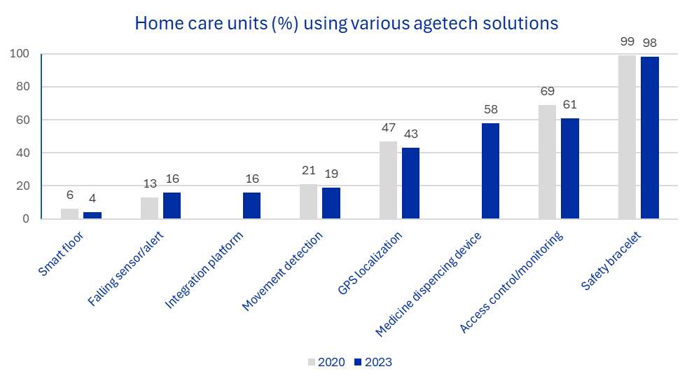
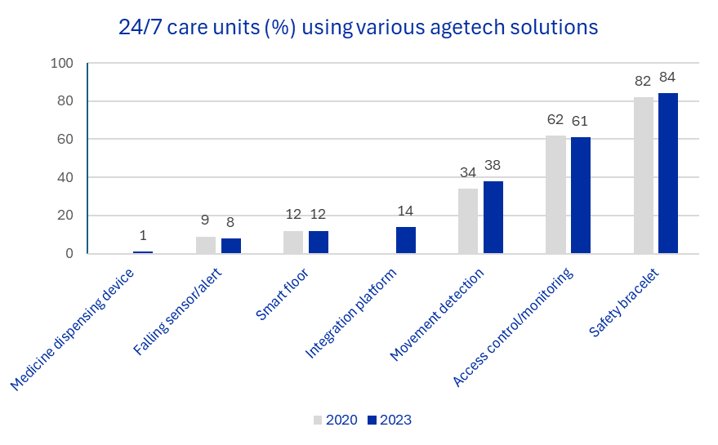
Agetech solutions in use 2020 and 2023
The data is based on a national follow-up survey* to all units of home care and 24/7 care for older adults in Finland
Automated medicine dispencing devices have become common in home care in a few years (the item not included in the 2020 survey)
Technology for remote homecare visits not been included in the survey yet, but based on information from wellbeing counties' websites, all wellbeing counties provide remote homecare visits.
* Kehusmaa, S., Honkanen, S., & Saukkonen, P. (Eds). (2024). Kehittyvät iäkkäiden palvelut Suomessa. Vanhuspalvelujen tila -seurannan tuloksia 2023. THL Raportti 5/2024. Terveyden ja hyvinvoinnin laitos. https://www.julkari.fi/bitstream/handle/10024/150082/URN_ISBN_978-952-408-324-9.pdf?sequence=1&isAllowed=y by the Finnish Institute for Health and Welfare (THL)

Slide 9








Real-world use of agetech in care services
Digital-first care model in wellbeing service counties
AI-assisted care notes in nursing homes
AI-powered predictions based on RAI data
IoT & AI platforms for risk alerts & services
Sensor-based monitoring in homecare settings
Automates medicine dispensing
Enables virtual homecare visits
Sends alerts via sensors to caregivers
Uses speech recognition for notes
Reduces documentation time by 50%
Supports caregiver focus on patient care
Identifies fall and pain risks
Detects early decline in function
Supports timely preventive care
Sends alerts from health risks
Recommends personalized services
Supports holistic care approach
Tracks homecare client safety
Engages family caregivers
Sends real-time alerts if needed
Examples

Slide 10
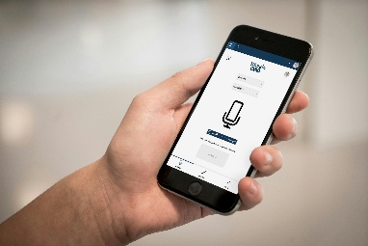




REFERENCE CASE:
AI-assisted care notes in residential care
Challenge
Solution
Benefit
In 2025, there is 366 000 employees in the social and healthcare sector in Finland. 200 000 new professionals are required in the next 10 years
In elderly 24/7 residental care, nurses spend 46-48 minutes on documentation per day (Finnish Institute for Health and Welfare, 2023)
The amount of documentation is still increasing and according to professionals, one third is redundant
Attendo and Efima developed an AI assistant that enables real-time documentation of client information from free-form speech to structured documentation
The RPA-based AI assistant utilizes Microsoft Azure speech recognition technology, OpenAI language models, and additional AI components developed by Efima
The AI assistant enables richer and faster note-taking and allows more time for meaningful interactions with clients
Based on the pilot in Attendo residential care:
The time spent on note-taking could be reduced from 45 min to 20 minutes, which corresponds to 6 percent of working time – in permanent use the saving will increase
The AI assistant reduces the amount of information that the nurse needs to keep in memory (until the end of the shift), alleviating cognitive load and stress
Study by the Finnish Institute of Occupational Health (2025)
Artificial intelligence frees up more time for care work – Attendo, Efima, and Microsoft collaborate on new solutions

Slide 11

REFERENCE CASE:
Technology for Home Care in South Karelia Wellbeing Services County
Virtual homecare visits
Automated medicine dispensing
Delivers scheduled video calls between homecare nurses and clients, enabling services like medication reminders, wellbeing checks, guide rehabilitation exercises and to provide recreational and cultural activities
Reduces the need for in-person visits while maintaining regular contact and care quality
Improves cost-efficiency and sustainability by lowering travel needs for care staff and reducing emissions, while also helping combat loneliness through virtual social programs
Automatically dispenses pre-packed medications or prefilled medication cups at the right time to ensure safe and accurate medication
Reduces the need for physical nurse visits, improving efficiency in healthcare services
Enables remote monitoring and alerts for caregivers, enhancing safety and reducing workload
Sensor-based monitoring and alerts to caregivers
IoT & AI platforms for risk alerts & services
Enable 24/7 emergency communication through a wrist-worn button or automatic sensors (e.g. fall and door alarms, smoke detectors, and GPS watches )
Technologies supports independent living and enhance safety at home.
Reduce the need for constant in-person monitoring, allowing care resources to be used more efficiently while giving peace of mind to both clients and their families.
Monitors patients in home care and nursing homes, using AI to detect early signs of health changes and predict care needs
Improves medication safety by identifying potential drug-related issues and deviations
Reduces emergency visits and hospital stays, helping clients live at home longer while optimizing care resources

Slide 12
Agetech expertise and other resources

Slide 13
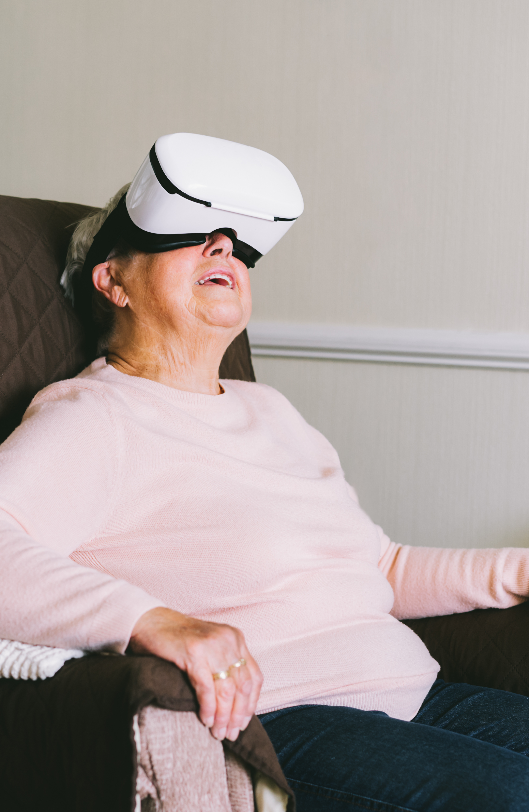
Agetech research organizations
DIGITAL HEALTH FINLAND
Centre of Excellence in Research on Ageing and Care (CoE AgeCare), University of Jyväskylä¹
LAB University of Applied Sciences (Lahti) – Digital Transformation in Health and Safety²
LUT University (Lappeenranta and Lahti)³
Metropolia University of Applied Sciences (Helsinki) – Center of Excellence in Ageing⁴
Social Research Center for Welfare Technology, University of Eastern Finland⁵
THL - Finnish Institute for Health and Welfare⁶
¹ https://www.jyu.fi/en/research/centres-of-excellence/centre-of-excellence-in-research-on-ageing-and-care
² https://lab.fi/en/RDI/research-groups/digital-transformation-health-and-safety
³ https://www.lut.fi/en/research/focus-areas/business-and-society
⁴ https://www.metropolia.fi/en/rdi/center-of-excellence-in-ageing
⁵ Welcome! - Social Research Center for Welfare Technology
⁶ https://thl.fi/en/main-page

Slide 14

Agetech expertise and services
DIGITAL HEALTH FINLAND
GeroNursing Centre (GNC)¹, University of Oulu
Research, education and networks for ​both the successful aging of older adults and the well-being at work of health care professionals
Education as online courses based on scientific research
LAB University of Applied Science²
Gerontology education with agetech innovation and co-design approach
Nordic Healthcare Group (NHG)³
Supporting agetech implementation through expertise of health and social care
Coordinator of the Finnish Agetech Network with 250 members as a partner of the Ministry of Social Affairs and Digital Health of Finland
VALLI Gerontechnology Centre⁴
Agetech know-how, information sharing and networking
Wenla Health and Welfare Technology Directory⁵
Search and browsing service for wellness and healthcare technologies on the market
¹ In English | Gero Nursing Centre (GNC)
² https://lab.fi/en
³ https://nordichealthcaregroup.com/
⁴ https://www.valli.fi/tyomuotomme/ikateknologiakeskus/in-english/
⁵ Etusivu - Wenla - Hyvinvointi- ja terveysteknologiahakemisto (in Finnish)

Slide 15
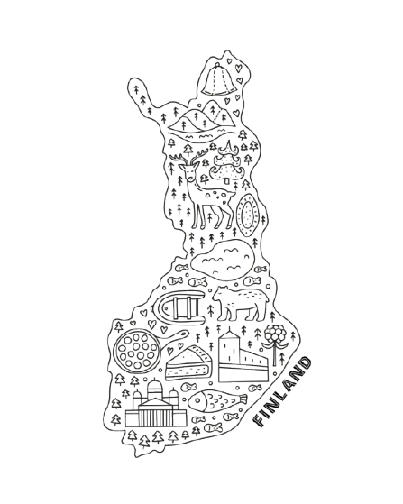

Visiting sites (care providers)
# | Site | Service | Description
A | Attendo Vuoripirtti Espoo | Nursing home with AI | Attendo Vuoripirtti is a home for the elderly located in Tillinmäki, Espoo. The care home offers round-the-clock care, short-term service housing to ease the daily life of family caregivers, and lighter service housing. Vuoripirtti and Efima company have developed an AI application for care note-taking based on speech recognition technology and a language model. The application has significantly reduced the logging time and improved the quality of notes. Caregivers can dictate records in real time, even on their phones.
B | Kustaan-kartano, Helsinki | Nursing home with agetech | Kustaankartano provides a range of housing, care, and rehabilitation services, as well as engaging day activities, at the city's senior centres and service homes. Also places in a private service home. Long term living provided to over 300 clients. Kustaankartano collaborates with the innovation company Forum Virium of the City of Helsinki and participates in agetech testing and pilots. Technologies are also in permanent use: Smart floors, GPS location-tracking, Oioi digital and multisensoral walls.
C | South Karelia Wellbeing Services County | Home care and remote home care | South Karelia​​ produces health services, family and social welfare services, and services for the elderly in the region. The wellbeing services county ​​ is a joint municipal authority covering nine municipalities. 94% of the 75+ year-old inhabitants live at home. Home care is supported by a variety of technological aids, easy to use for the older adult. Remote home care is provided through virtual homecare visits, automated medicine dispending devices and predictive AI preventing falls and health problems.
C
A
B

Slide 16
Testbeds for agetech – also for international partners
# | Testbed | Operator | Description
A | Pohde Wellbeing Lab | Wellbeing services county of North Ostrobothnia | Pohde WellbeingLab (OuluHealth Labs) enables developing solutions and innovating with real end-users in authentic environments – homes, social and healthcare centres and hospitals.
B | Satakunta Testbed, Funteeraamo Showroom | Satakunta University of Applied Sciences, Prizztech Oy | Satakunta Testbed provides tailored research and development services for companies and supports healthcare providers to find and test suitable technologies. Maintains an open directory Wenla.fi for technologies and digital solutions for social and health care and wellbeing. Experience of innovating with older people. Funteeraamo showroom introduces various health and wellbeing technologies, applications and digital contents with easy access, advice and borrowing service.
C | SeAMK Wellbeing Labs | Seinäjoki University of Applied Sciences | SeAMK Wellbeing Labs is the development and learning environment of the fields of health care and social work of Seinäjoki University of Applied Sciences (SeAMK).
D | Testbed Helsinki, Health Proof Helsinki | City of Helsinki, Forum Virium Helsinki, Metropolia Proof Health, HUS Helsinki University Hospital | Testbed Helsinki provides the whole City of Helsinki as a testbed for new innovations. Companies and RDI actors can develop and experiment products or services in an authentic city environment. Key focus areas: EdTech, Smart Traffic, Built Environment, Circular Economy and Health & Wellbeing. Health Proof Helsinki provides a unified service entity in the fields of health technology and medical technology: early-stage preclinical testing environments and expertise (Metropolia Proof Health), research and testing environments and expertise in primary health care and social work (City of Helsinki), and research environments and expertise in specialist care and diagnostics (HUS Helsinki University Hospital).
E | Sote Virtual Lab | Tampere University of Applied Sciences | In the Virtual Lab for Social and Health Care, RDI actors can develop, test and put forward ideas on tomorrow’s digital and intelligent technologies related to basic health care, safe and well-performing home environment, remote care and rehabilitation, telemedicine, and mobile healthcare services.
F | LAB WellTech | LAB University of Applied Sciences, Lahti and Lappeenranta | LAB WellTech RDI service is part of LAB Faculty of Health Care and Social Services, dedicated to supporting and enhancing wellbeing in society. LAB WellTech provides RDI expert services and valuable partner network including partnership for businesses, wellbeing services counties, and other organizations. Campus premises include Home Lab, Care Simulation Rooms and Co-Design Lab with up-to-date technology and equipment for elderly care R&D.
A
C
A https://ouluhealth.fi/pohde-wellbeinglab/
B https://www.satakuntatestbed.fi/en/; https://satakunnanhyvinvointialue.fi/palvelut/ikaantyneet/kotona-asumisen-tukipalvelut/funteeraamo/ (in Finnish)
C https://wellbeinglabs.seamk.fi/en/
D https://testbed.hel.fi/en/health-and-wellbeing/; https://www.healthproofhelsinki.fi/
E https://sites.tuni.fi/vlabforhealth/
F https://www.labwelltech.fi/eng/
B
E
F
D

Slide 17
Agetech research and reports
DIGITAL HEALTH FINLAND
Ecosystem model with citizens needs in focus (Päijät-Häme Wellbeing Services County). In Book: Nordic Welfare Centre (2022). Integrated Healthcare and Care through distance spanning solutions – for increased service accessibility. https://nordicwelfare.org/pub/Integrated_Healthcare_and_Care_through_distance_spanning_solutions_v4/
Niemelä, M. (2022). The Use of Robotic and Smart Technologies in Finland to Support Older Adults Living at Home. ASEM Global Ageing Center Issue Focus, 3(3), 19–28.
Niemelä, M., Heikkinen, S., Koistinen, P., Laakso, K., Melkas, H., & Kyrki, V. (Eds). (2021). Robots and the Future of Welfare Services: A Finnish Roadmap. Aalto University. https://urn.fi/URN:ISBN:978-952-64-0323-6
Anttila, H., Anttila, M., Koivisto, S., Niemelä, M., Kaartinen, J., Forsius, P., Kauppinen, S., & Luoma, M.-L. (2023). Kotihoidon uudet ratkaisut: Kotona asumisen teknologiat ikäihmisille - KATI-ohjelman 2020-2023 loppuraportti. Terveyden ja hyvinvoinnin laitos THL. https://www.julkari.fi/handle/10024/147940 (in Finnish)

Slide 18


DIGITAL HEALTH FINLAND
Contacts
Agetech Finland
Pia Pehrsson, NHG Finland pia.pehrsson@nhg.fi
Eveliina Kelahaara, NHG Finland eveliina.kelahaara@nhg.fi
Digital Health Finland
Veera Virta, Oulu University veera.virta@oulu.fi
Photo: Sakari Piippo

Slide 19
Thank you!

